Slide 1


Harbin Engineering University
Impact angle constrained guidance for all-aspect interception with function-based finite-time sliding mode control

Slide 2
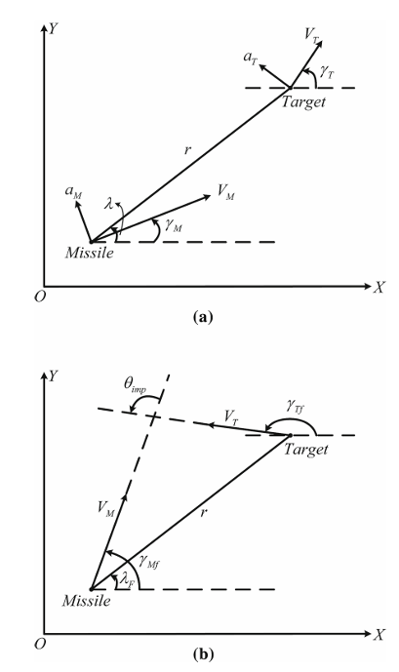
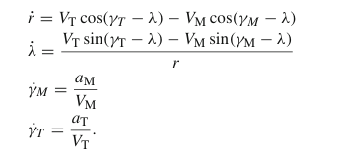


Harbin Engineering University

Slide 3
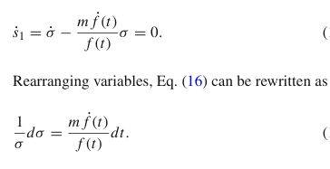

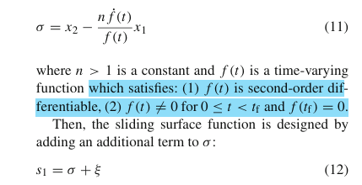
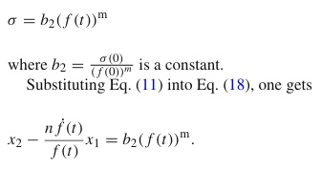
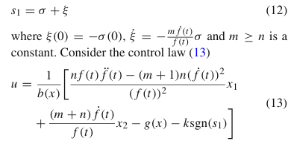
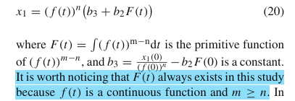
Harbin Engineering University

Slide 4


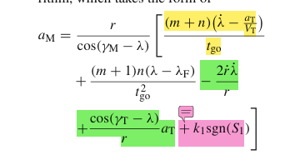




Harbin Engineering University
回到原有的制导方程上面
扩张状态观测器

Slide 5
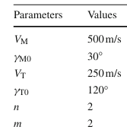
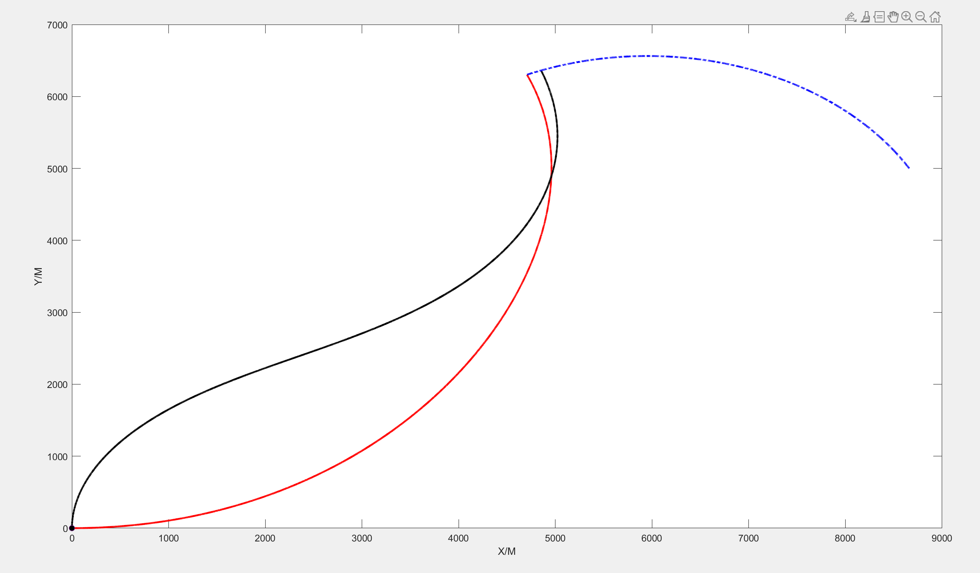
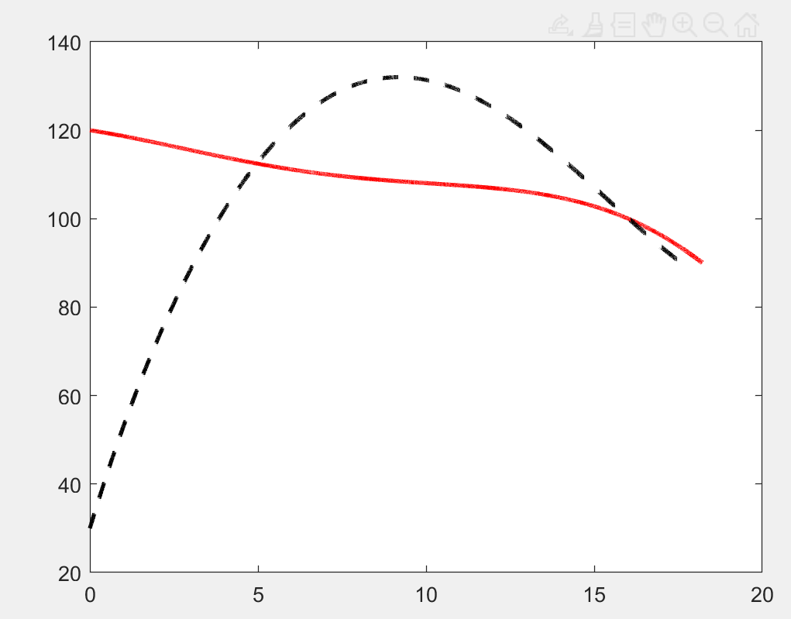
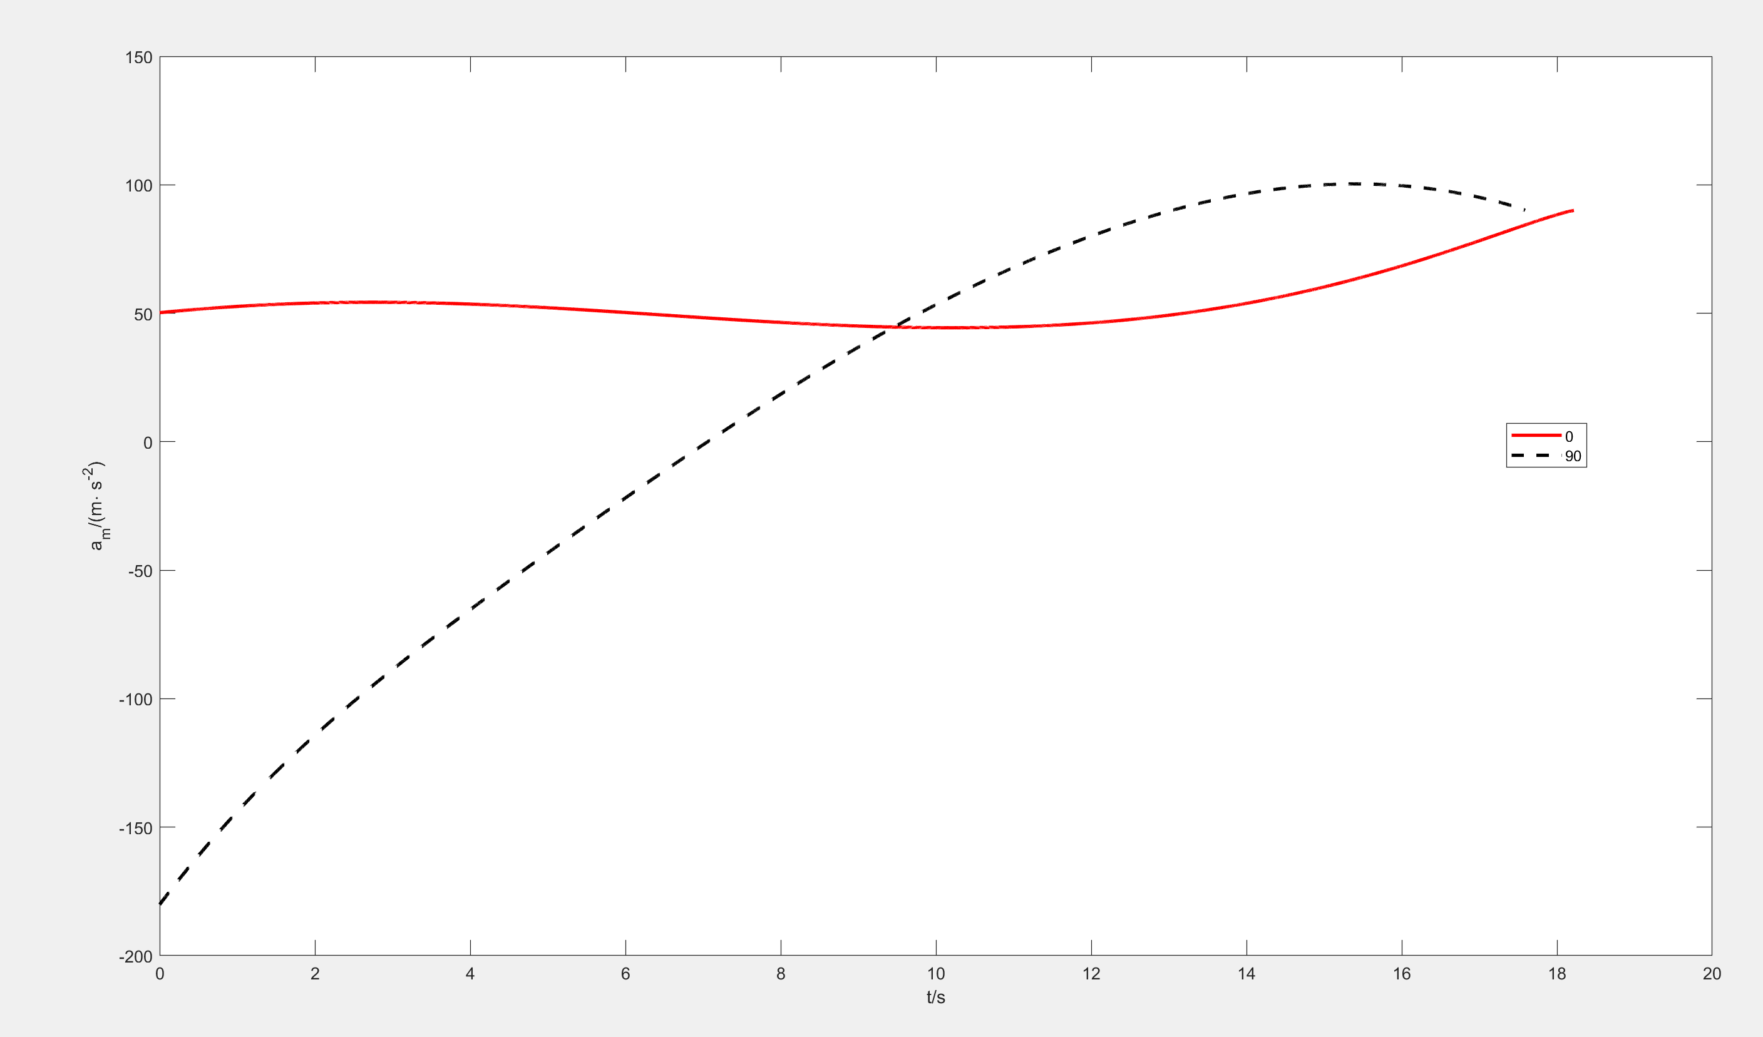
Harbin Engineering University
初始速度角分别是0°和90°的弹道
撞击角度是90°

Slide 6

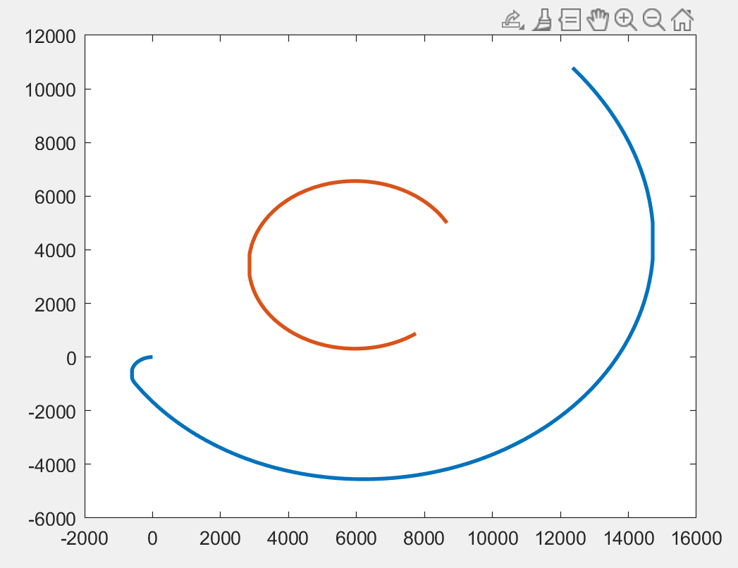

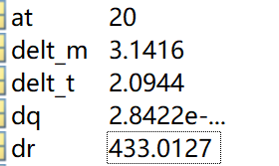
Harbin Engineering University
初始的速度角是-180°
：

Slide 7
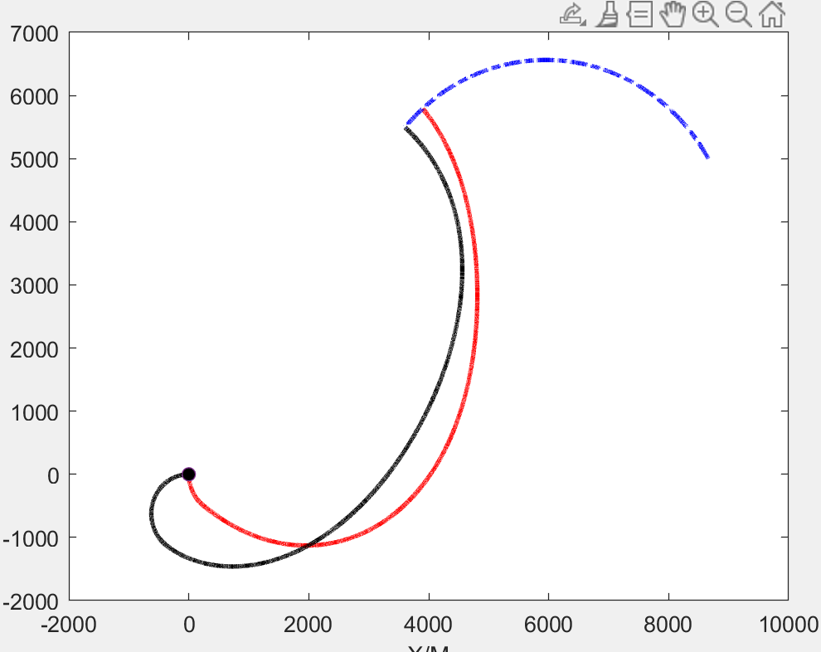
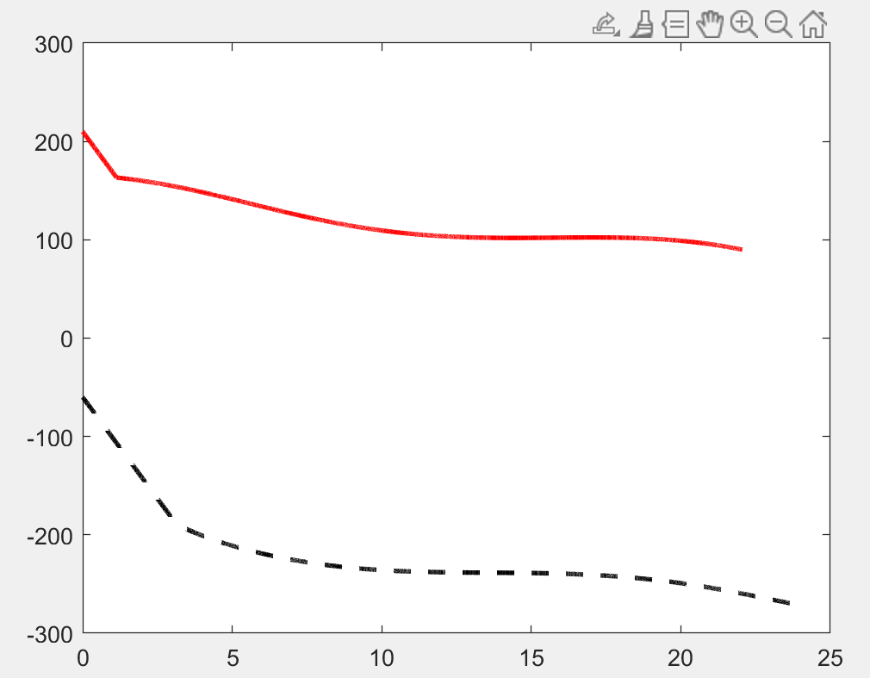
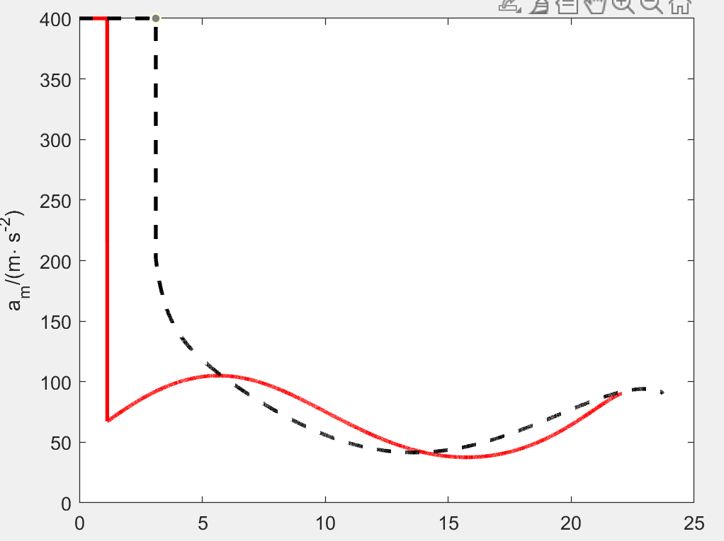
Harbin Engineering University

Slide 8






Harbin Engineering University
Finite-Horizon Robust Suboptimal Control-Based Impact Angle Guidance

Slide 9







Harbin Engineering University

Slide 10
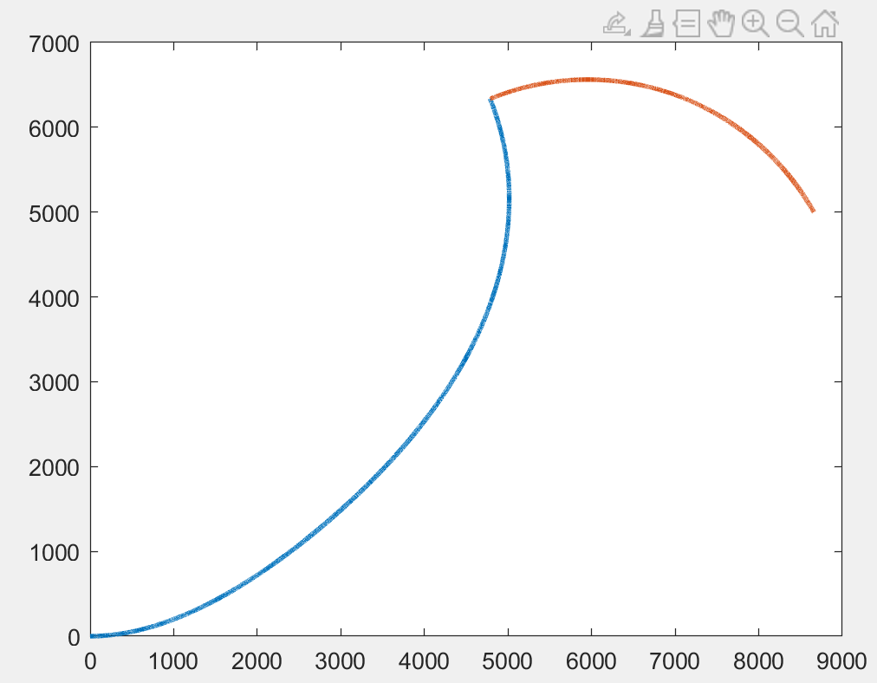
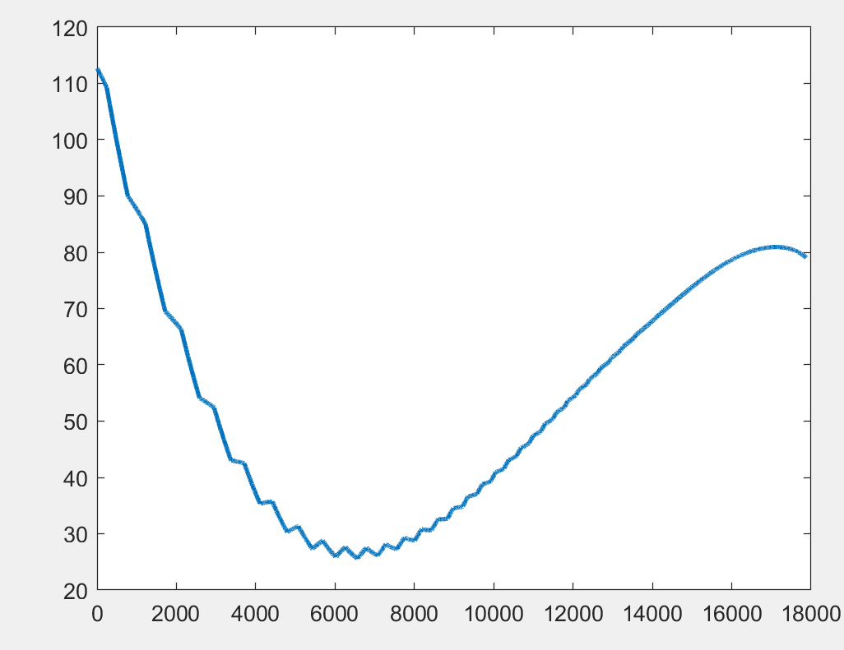


Harbin Engineering University
初始速度角为0°
滑模 | FTSDRE
82343 | 77476

Slide 11


Harbin Engineering University
谢谢！

